Slide 1

Exploratory Data Analysis ON NETFLIX

Slide 2
WHAT IS EDA?
Exploratory Data Analysis (EDA) is the initial process of analyzing, summarizing, and visualizing a dataset to understand its structure, patterns, anomalies, and relationships before applying any advanced modeling.
Purpose of EDA:
Understand what the data contains
Detect missing values, errors, or outliers
Identify trends, patterns, and relationships
Here we have Netflix data, EDA would include:
How many movies vs. TV shows
Which genres are most common

Slide 3

INTRODUCTION:
Netflix is one of the world’s largest streaming platforms, offering a wide variety of movies and TV shows across different countries, genres, and ratings.
This project performs Exploratory Data Analysis (EDA) on the Netflix dataset to understand:
Content distribution (Movies vs. TV Shows)
Popular genres and ratings
Yearly content trends
Country-wise availability and contribution
The main goal is to uncover insights about Netflix’s global content strategy and viewing patterns.

Slide 4
AIM OF THE PROJECT:
The aim of this project is to explore and analyze Netflix’s content catalog to identify meaningful trends and patterns.
Specifically, the analysis seeks to:
Understand how Netflix’s content varies across genres and countries.
Analyze the distribution of movies and TV shows.
Identify trends in the release and addition of content over time.
Study common ratings, durations, and popular categories.
Draw insights that could help content creators and marketers understand viewer preferences.

Slide 5

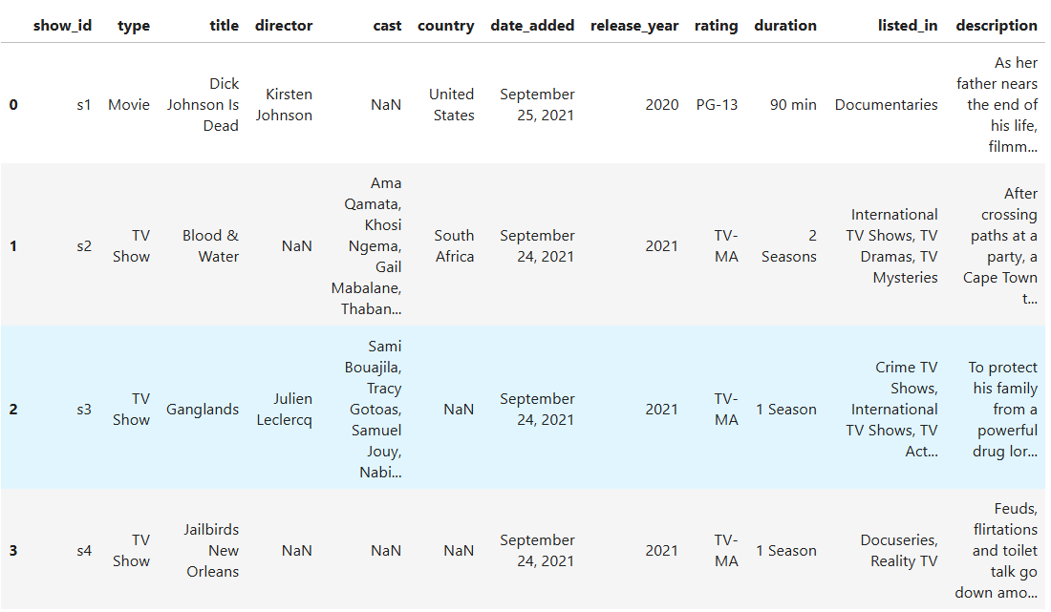
OVERVIEW OF DATASET
A dataset containing information about Netflix Movies and TV Shows such as title, director, cast, country, release year, rating, duration, and genre.

Slide 6
IMPORT LIBRARIES USED:
PANDAS - Used for data loading, cleaning, and analysis.
MATPILOTLIB - Used to create basic plots and charts for visualizing data.
NUMPY - Provides fast numerical calculations and array operations.
SEABORN - Builds advanced, attractive statistical visualizations on top of matplotlib.

Slide 7
DATA CLEANING:
Removed duplicate rows
Ensured no repeated entries exist in the dataset.
Handled missing values
Filled or removed missing data in columns like director, cast, and country.
Converted the ‘date_added’ column to datetime format
Standardized the date to extract year and month.
Extracted new features
Created year_added and month_added from the date column.
Split the ‘duration’ column
Separated it into numeric values and units (minutes / seasons).
Standardized text formatting
Cleaned extra spaces, inconsistent separators, and unwanted characters.

Slide 8
EXPLORATORY DATA ANALYSIS:
Movies vs TV Shows distribution
Checked how many titles are movies and how many are TV shows.
Year-wise trend of titles added
Found how Netflix’s content grew over the years.
Top countries producing content
Identified which countries contribute the most to Netflix.
Most common genres
Analyzed categories such as Dramas, Comedies, etc.
Rating distribution
Checked maturity ratings like TV-MA, TV-14, PG, etc.
Duration of content
Studied movie runtime patterns and number of seasons for shows.

Slide 9
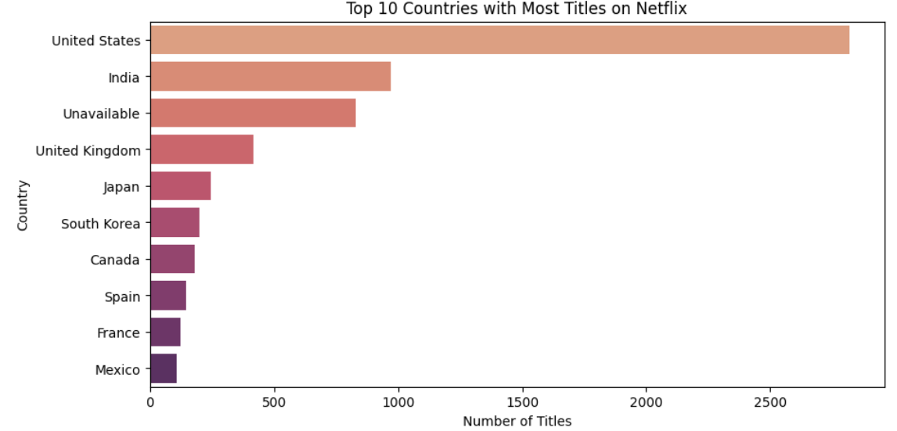
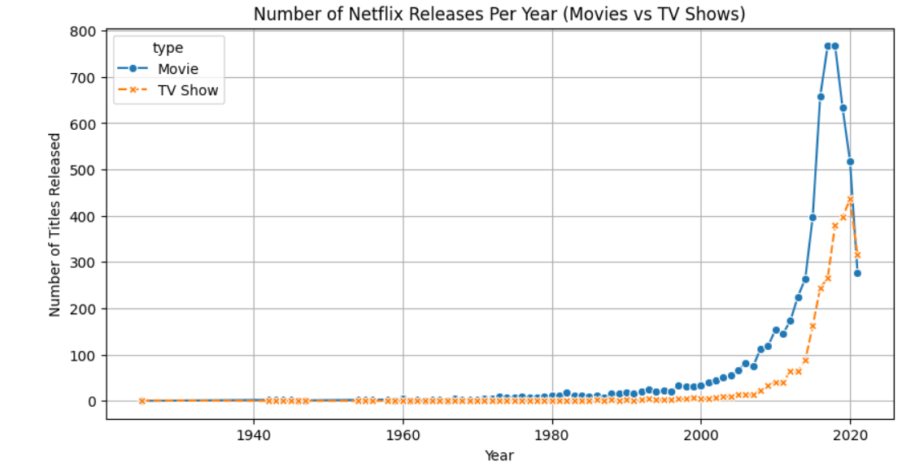
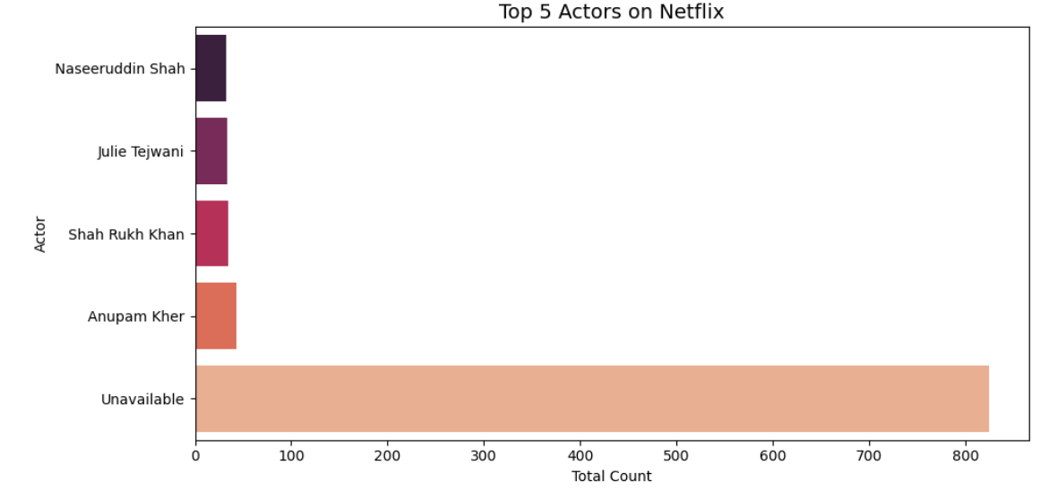
VISUAL INSIGHTS:

Slide 10
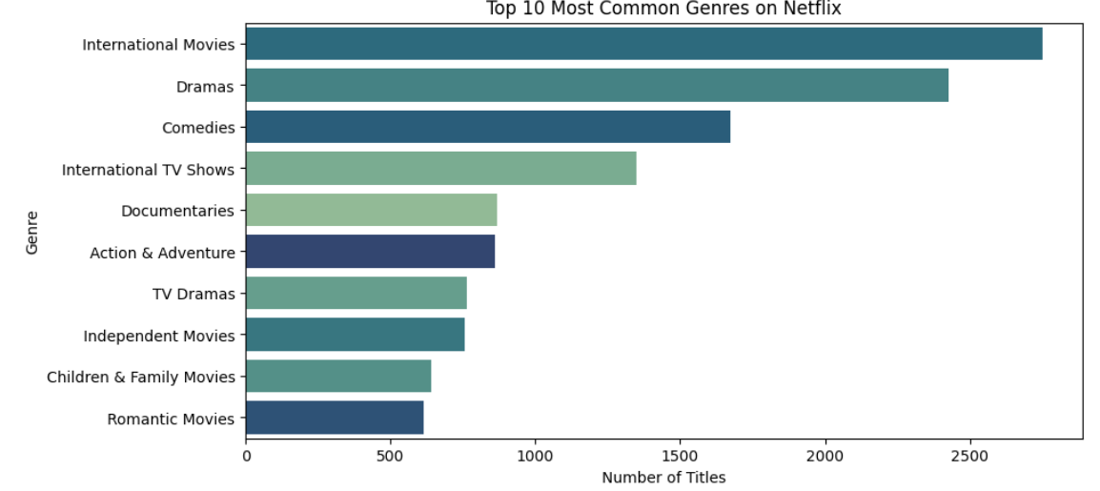
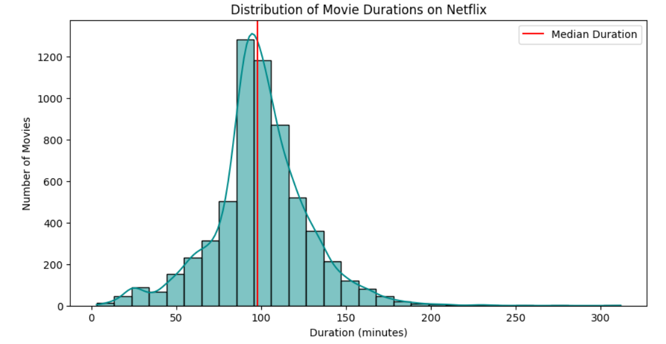
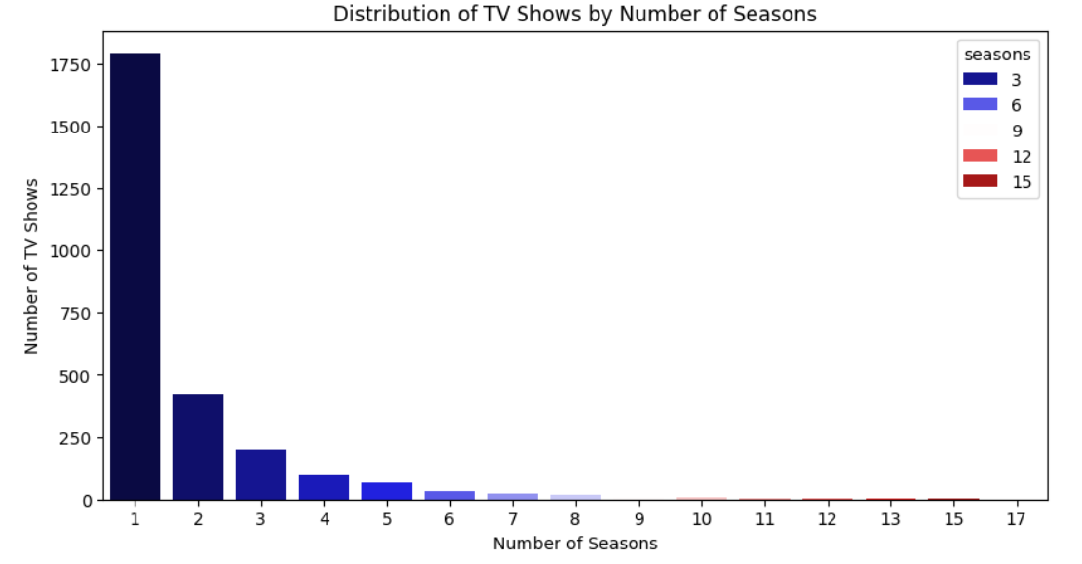
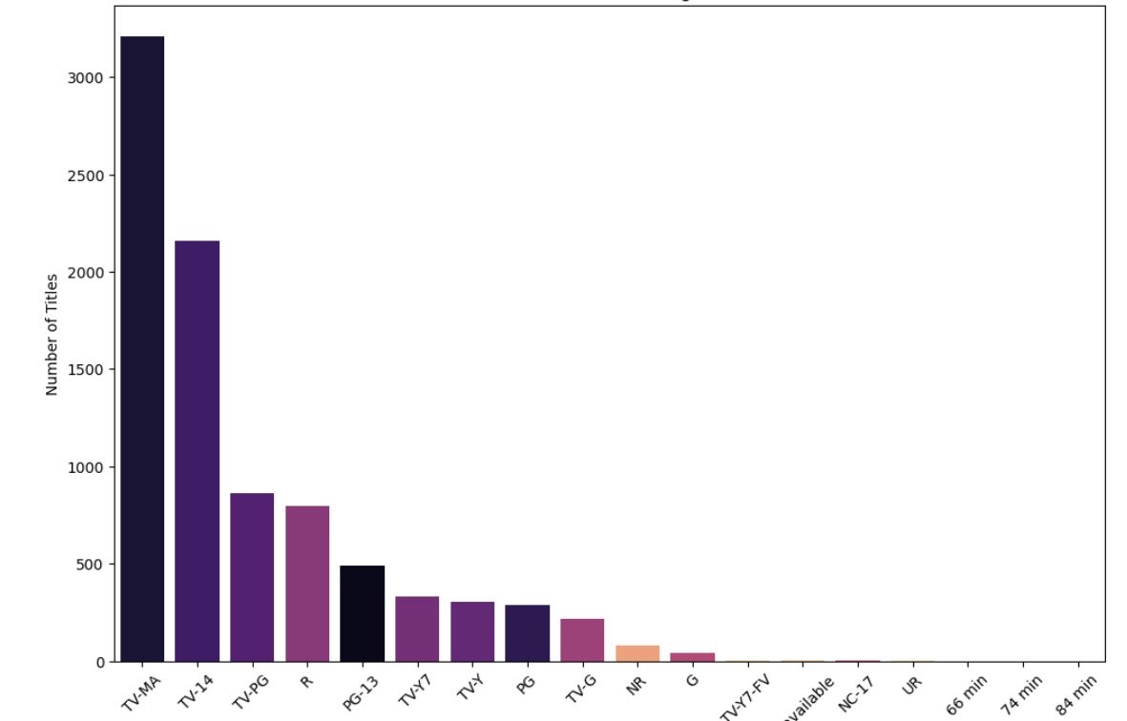

Slide 11

LOGISTIC REGRESSION ALGORITHM
Logistic Regression is a supervised machine learning algorithm used for binary classification (two output categories).
It predicts whether something belongs to Class 0 or Class 1 by giving a probability between 0 and 1.
SIGMOID FUNCTION FORMULA
In this Project:
Logistic Regression can be used to classify a Netflix title as:
Movie (0)
TV Show (1)
based on features like duration, rating, release_year, etc.

Slide 12
CONCLUSION:
Netflix has more Movies than TV Shows, showing a movie-dominant platform.
Dramas, Comedies, and International Movies are the most popular genres.
Most content comes from USA, India, and UK, proving Netflix’s global production base.
The majority of shows are rated TV-MA or TV-14, meaning Netflix focuses heavily on mature audiences.
Netflix's content library grew rapidly after 2015, showing fast expansion.
Netflix strategically invests in mature, drama-based content.
The platform is expanding internationally, adding more content from multiple countries.
Viewer preferences are shifting toward diverse and global genres.

